Slide 1

Asynchronous Programming and Promises
Promises. Async / Await.
SoftUni Team
Technical Trainers
Software University
http://softuni.bg

Slide 2
Table of Contents
Asynchronous Programming
Promises - Concepts
Promises with AJAX
Using Async / Await

Slide 3
Have a Question?
sli.do #JS-CORE

Slide 4
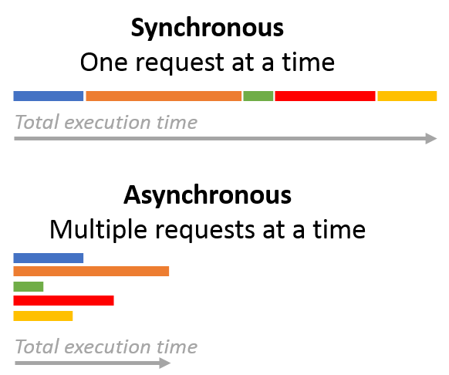
Asynchronous Programming
Synchronous vs Asynchronous

Slide 5
Asynchronous Programming
Deals with the needs to run several tasks in parallel
Asynchronous Programming is based on callbacks
There can be asynchronous code, but it is generally single-threaded
Handled with:
Promises
Async / Await pattern

Slide 6
Asynchronous Programming
Synchronous
Asynchronous
Number of tasks
Number of tasks
1
1
20 seconds
20 seconds
2
2
7 seconds
7 seconds
3
3
10 seconds
10 seconds
4
4
8 seconds
8 seconds
Total time taken by the tasks:
45 seconds
Total time taken by the tasks:
20 seconds

Slide 7
Asynchronous Programming - Example
The following commands will be executed as follows:
console.log("Hello.");
// Hello.
setTimeout(function() {
console.log("Goodbye!");
}, 2000);
// Hello again!
// Goodbye!
console.log("Hello again!");

Slide 8
.then()
.catch()
Promises
Objects Holding Asynchronous Operations

Slide 9
What is a Promise?
An object holding an asynchronous operation
States:
Pending - operation still running (unfinished)
Fulfilled - operation finished (and the result is available)
Failed - operation is failed (and an error is available)
Promises use the Promise object
new Promise(executor);

Slide 10
What is a Promise?
returns
returns
. . .
Promise
Promise
then
then
resolve
onFulfilled
return data
resolve
onFulfilled
reject
onRejected
throw error
reject
onRejected

Slide 11
Promise Methods
Promise.reject(reason)
Returns an object that is rejected with the given reason
Promise.resolve(value)
Returns an object that is resolved with the given value
Promise.all(iterable)
Returns a promise that either fulfills when all of the promises have fulfilled or rejects as soon as one of them rejects

Slide 12
Promise.then() - Example
console.log('Before promise');
new Promise(function(resolve, reject) {
setTimeout(function() {
resolve('done');
}, 500);
})
.then(function(result) {
console.log('Then returned: ' + result);
});
// Before promise
Resolved after 500 ms
// After promise
// Then returned: done
console.log('After promise');

Slide 13
Promise.catch() - Example
console.log('Before promise');
new Promise(function(resolve, reject) {
setTimeout(function() {
reject('fail');
}, 500);
})
.then(function(result) { console.log(result); });
.catch(function(error) { console.log(error); });
// Before promise
// After promise
Rejected after 500 ms
// fail
console.log('After promise');

Slide 14

Promises with jQuery AJAX

Slide 15
jQuery Promise
The Deferred object is a chainable utility object.
Can register multiple callbacks into callback queues
Invoke callback queues and relay the success or failure state of a function
Is thenable - can be casted to native Promise
Some of the arguments passed to then() method will be discarded

Slide 16
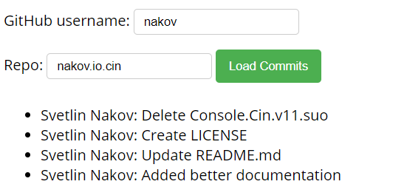
Problem: Load GitHub Commits with AJAX
GitHub username:
<input type="text" id="username" value="nakov" /> <br>
Repo: <input type="text" id="repo" value="nakov.io.cin" />
<button onclick="loadCommits()">Load Commits</button>
<ul id="commits"></ul>
<script>
function loadCommits() {
// AJAX call …
}
</script>

Slide 17
Solution: Load GitHub Commits with AJAX
function loadCommits() {
$("#commits").empty();
let url = "https://api.github.com/repos/" +
$("#username").val() + "/" +
$("#repo").val() + "/commits";
$.get(url)
.then(displayCommits)
.catch(displayError);
function displayCommits(commits) { … }
function displayError(err) { … }
}
jQuery AJAX methods return promises

Slide 18
Solution: Load GitHub Commits with AJAX (2)
function displayCommits(commits) {
for (let commit of commits)
$("#commits").append($("<li>").text(
commit.commit.author.name + ": " +
commit.commit.message
));
}
function displayError(err) {
$("#commits").append($("<li>").text("Error: " +
err.status + ' (' + err.statusText + ')'));
}
Check your solution here: https://judge.softuni.bg/Contests/1570

Slide 19
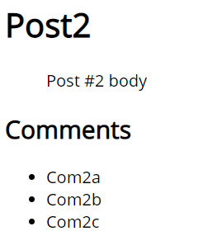
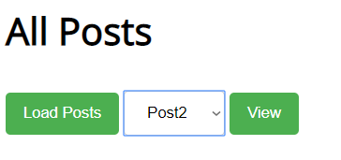
Problem: Blog
Create a Kinvey app and then add user "peter" with password "p"
Create comments "Com1a" and "Com1b" for "Post1
Create comments "Com2a", "Com2b" and "Com2c" for "Post2“
Display all posts and view the selected post along with its comments

Slide 20
Solution: Blog - Create First Post
Insert your Kinvey App ID here
POST /appdata/kid_S1htVfcmm/posts/ HTTP/1.1
Host: baas.kinvey.com
Authorization: Basic cGV0ZXI6cA==
Content-Type: application/json
{ "title":"Post1", "body":"Post #1 body" }
Base64(user:pass)
{ "title": "Post3", "body": "Post #3 body", …,
"_id": "5c9a3e3b13ebac4e57c0451e" }
Remember the post _id

Slide 21
Solution: Blog - Create Comments
POST /appdata/kid_S1htVfcmm/comments/ HTTP/1.1
Host: baas.kinvey.com
Authorization: Basic cGV0ZXI6cA==
Content-Type: application/json
{ "text":"Com1a", "post_id":"5c9a3e3b13ebac4e57c0451e" }
Use post _id from the previous request
POST /appdata/kid_S1htVfcmm/comments/ HTTP/1.1
Host: baas.kinvey.com
Authorization: Basic cGV0ZXI6cA==
Content-Type: application/json
{ "text":"Com2a", "post_id":"5c9a3e3b13ebac4e57c0451e" }

Slide 22
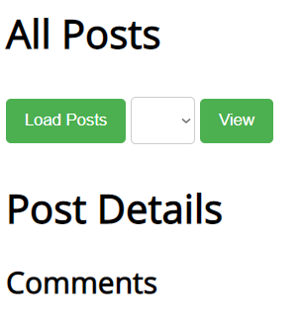
Solution: Blog - HTML Code
<script src="jquery-3.1.1.min.js"></script>
<script src="blog.js"></script>
<h1>All Posts</h1>
<button id="btnLoadPosts">Load</button>
<select id="posts"></select>
<button id="btnViewPost">View</button>
<h1 id="post-title">Post Details</h1>
<ul id="post-body"></ul>
<h2>Comments</h2>
<ul id="post-comments"></ul>

Slide 23
Solution: Blog - JS Code
$(document).ready(function() {
const kinveyAppId = "kid_S1htVfcmm";
const serviceUrl = "https://baas.kinvey.com/appdata/" +
kinveyAppId;
const kinveyUsername = "peter";
const kinveyPassword = "p";
const base64auth = btoa(kinveyUsername + ":" +
kinveyPassword);
const authHeaders = { "Authorization": "Basic " + base64auth };
$("#btnLoadPosts").click(loadPostsClick);
$("#btnViewPost").click(viewPostClick);
function loadPostsClick() { … }
function viewPostClick() { … }
…
});

Slide 24
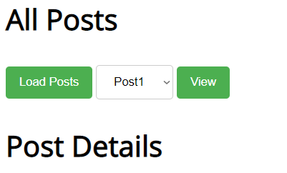
Solution: Blog - Load Posts
function loadPostsClick() {
let loadPostsRequest = {
url: serviceUrl + "/posts",
headers: authHeaders,
};
$.ajax(loadPostsRequest)
.then(displayPosts)
.catch(displayError);
}

Slide 25
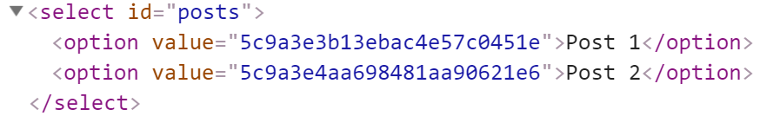
Solution: Blog - Display Posts as Options
function displayPosts(posts) {
$("#posts").empty();
for (let post of posts) {
let option = $("<option>")
.text(post.title)
.val(post._id);
$("#posts").append(option);
}
}

Slide 26
Solution: Blog - Handle AJAX Errors
function displayError(err) {
let errorDiv = $("<div>").text("Error: " +
err.status + ' (' + err.statusText + ')');
$(document.body).prepend(errorDiv);
setTimeout(function() {
$(errorDiv).fadeOut(function() {
$(errorDiv).remove();
});
}, 3000);
}

Slide 27
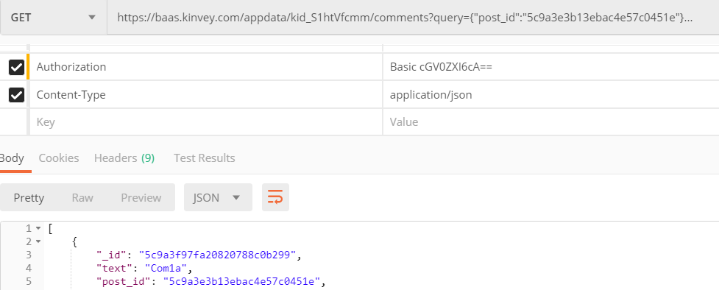
Solution: Blog - Load Post Comments Query
Kinvey allows querying collections:
https://baas.kinvey.com/appdata/kid_S1htVfcmm/comments ?query={"post_id":"5c9a3e3b13ebac4e57c0451e"}

Slide 28
Solution: Blog - [View Post] Button Click
function viewPostClick() {
let selectedPostId = $("#posts").val();
if (!selectedPostId) return;
let requestPosts = $.ajax({
url: serviceUrl + "/posts/" + selectedPostId,
headers: authHeaders });
let requestComments = $.ajax({ url: serviceUrl + `/comments/?query={"post_id":"${selectedPostId}"}`,
headers: authHeaders });
Promise.all([requestPosts, requestComments])
.then(displayPostWithComments)
.catch(displayError);
}

Slide 29
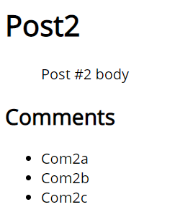
Solution: Blog - Display Post with its Comments
function displayPostWithComments([post, comments]) {
$("#post-title").text(post.title);
$("#post-body").text(post.body);
$("#post-comments").empty();
for (let comment of comments) {
let commentItem = $("<li>")
.text(comment.text);
$("#post-comments")
.append(commentItem);
}
}
Check your solution here: https://judge.softuni.bg/Contests/1570

Slide 30
Async / Await
Simplified Promises

Slide 31
Async Functions
Operate asynchronously via the event loop
Contain an await expression that:
Is only valid inside async functions
Pauses the execution
Waits for the Promise's resolution
Async / Await is similar to combining generators and promises

Slide 32
Async Functions (2)
function resolveAfter2Seconds() {
return new Promise(resolve => {
setTimeout(() => {
resolve('resolved');
}, 2000);
});
}
Expected output:
// calling
// resolved
async function asyncCall() {
console.log('calling');
var result = await resolveAfter2Seconds();
console.log(result);
}

Slide 33
Async Functions (3)
Do not confuse await with Promise.then()
To await two or more promises in parallel, use Promise.then()
If a promise resolves normally, then await promise returns the result
In case of a rejection, it throws an error
async function f() { try {
let response = await fetch();
let user = await response.json();
} catch (err) {
// catches errors both in fetch and
response.json
alert(err);
}
}
async function f() {
let response = await fetch();
}
// f() becomes a rejected promise
f().catch(alert);

Slide 34
Sequential Execution
To execute different promise methods one by one, use Async /Await
function doJob(x,sec) {
return new Promise(resolve => {
console.log('Start: ' + x);
setTimeout(() => {
console.log('End: ' + x);
resolve(x);
}, sec *1000);
});
}
async function SerialFlow() {
let result1 = await doJob(1,1);
let result2 = await doJob(2,2);
let result3 = await doJob(3,3);
let finalResult = result1 + result2 + result3;
console.log(finalResult);
}
// Start: 1
// End: 1
// Start: 2
// End: 2
// Start: 3
// End: 3
// 6

Slide 35
Concurrent Execution
async function ParallelFlow() {
let result1 = doJob(1,1);
let result2 = doJob(2,2);
let result3 = doJob(3,3);
let finalResult = await result1 + await result2 + await result3;
console.log(finalResult);
}
// Expected output:
Start: 1
Start: 2
Start: 3
End: 1
End: 2
End: 3
6

Slide 36

Live Exercises

Slide 37

Summary
…
…
…
Promises hold operations
Can be resolved or rejected
jQuery AJAX works with promises
Async functions contain an await expression
It pauses the execution
Waits for the Promise's resolution

Slide 38
https://softuni.bg/courses/js-apps

Slide 39













SoftUni Diamond Partners

Slide 40




SoftUni Organizational Partners

Slide 41




Trainings @ Software University (SoftUni)
Software University - High-Quality Education and Employment Opportunities
softuni.bg
Software University Foundation
http://softuni.foundation/
Software University @ Facebook
facebook.com/SoftwareUniversity
Software University Forums
forum.softuni.bg

Slide 42

License
This course (slides, examples, demos, videos, homework, etc.) is licensed under the "Creative Commons Attribution-NonCommercial-ShareAlike 4.0 International" license

